Slide 1
CSc 553 Principles of Compilation 10. Interpreters and JIT Compilers
Saumya Debray
The University of Arizona
Tucson, AZ 85721

Slide 2
Overview

Slide 3
Interpreters
An interpreter is a program that executes another program.
implements a virtual machine, which may be different from the underlying hardware platform.
The virtual machine is often at a higher level of semantic abstraction than the native hardware.
“higher level of semantic abstraction” ≡ operations are closer to the source language
This can help portability, but affects performance.

Slide 4
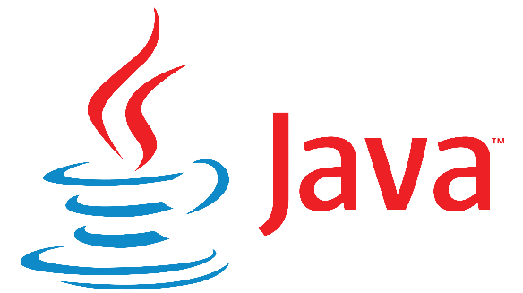

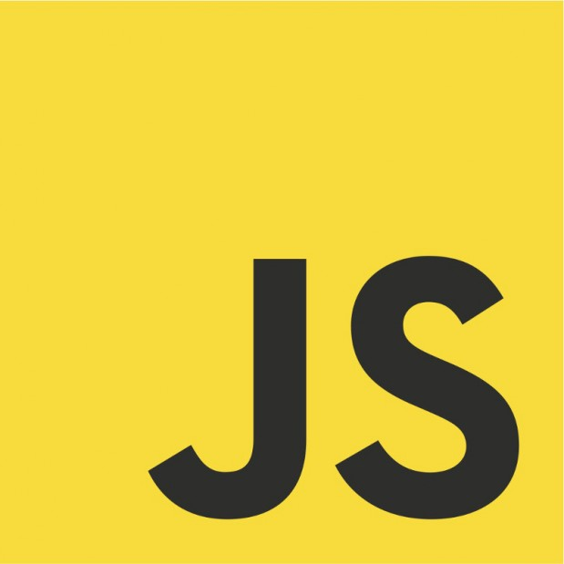



Some common language interpreters
JavaScript

Slide 5
Interpretation vs. Compilation
intermediate representation
assembly/ machine code
conventional compiler pipeline
source code
front end
back end
asm/
binary
hardware
high-level
interpreter
low-level
interpreter
E.g.:
Java Virtual Machine
CPython
E.g.:
SPIM

Slide 6
Interpreter Operation
ip = start of program /* ip ≡ instruction pointer */
while ( not done ) {
op = current operation at ip
execute code for op on current operands
advance ip to next operation
}

Slide 7
Example: High-level C-- interpreter
input program
int interp(ast_node *ast, environment *env) {
switch(ast->ntype) {
case ASSG:
rhs_val = interp(ast->child1, env);
update(env, ast->child0, rhs_val);
return rhs_val;
case PLUS:
val0 = interp(ast->child0, env);
val1 = interp(ast->child1, env);
return val0 + val1;
…
case ID:
return lookup(env, ast->name);
case INTCON:
return ast->value;
}
…
}
scanner
Interpretation:
"executing" the AST instead of generating code from it
parser
semantic checker
AST constructor
interpreter

Slide 8
Interpreters vs. Compilers

Slide 9
Interpreter operation
implemented in software
can be independent of the underlying hardware/OS
ip = start of program
while ( not done ) {
op = current operation at ip
execute code for op
advance ip to next operation
}
implemented in software
uses additional instructions, incurs a performance overhead

Slide 10
Interpreters vs. Compilers: Portability
Interpreted code is typically more portable than compiled binaries
easier to make them independent of the underlying hardware and/or OS
this is especially useful when the underlying hardware/OS is not known ahead of time, e.g.: web applications (Java, JavaScript)
Java was originally designed for the digital cable television industry
modern web browsers all have built-in support for JavaScript

Slide 11
Interpreters vs. Compilers: Performance
Interpretation incurs a performance overhead relative to compiled code
some languages (e.g., Python, JavaScript) have significant language-related overheads,* e.g.:
object allocation and deallocation, name lookups, dynamic type checking, garbage collection, …
for such languages, the additional % overhead due to interpretation may not be large
the benefits of portability and programming convenience then become important
See: M. Ismail and G. E. Suh, "Quantitative Overhead Analysis for Python", IEEE International Symposium on Workload Characterization, 2018, pages 36-47.

Slide 12
EXERCISE
On your first day at your new job at Acme Widgets Co., your boss puts you in charge of implementing a new in-house programming language. One of your decisions is whether to write an interpreter or a compiler.
How will you figure out which option is better?
what are the advantages of interpretation compared to compilation?
what are the disadvantages of interpretation compared to compilation?

Slide 13
Interpreters: Design Considerations

Slide 14
Interpreter Operation
ip = start of program /* ip ≡ instruction pointer */
while ( not done ) {
op = current operation at ip
execute code for op on current operands
advance ip to next operation
}
where?
where?
interpreter design considerations

Slide 15
Interpreter Design Issues
Encoding the operation
I.e., getting from the opcode to the code for that operation (“dispatch”):
byte code (e.g., JVM)
direct threaded code
Representing operands
register machines: operations are performed on a fixed set of global locations (“registers”) (e.g.: SPIM);
stack machines: operations are performed on the top of a stack of operands (e.g.: JVM)

Slide 16
Dispatch

Slide 17
Byte Code
Operations encoded as small integers
The interpreter uses the opcode to index into a table of code addresses:
Compact and portable, but can be slow
while ( TRUE ) {
byte op = ∗ip;
switch ( op ) {
case ADD: … perform addition; break;
case SUB: … perform subtraction; break;
…
}
}

Slide 18
Digression: switch statements
Source code
Machine code
switch ( e ) {
case 12: A;
case 13: B;
...
case 26: W;
}
t1 = evaluate(e)
t1 = t1 – 12
t2 = (t1 < 0 || t1 > 14)
if t2 goto L_{default}
t3 = &JmpTbl
t1 = t1 * 8 /* 64-bit */
t3 = t3 + t1
jmp *t3
normalize
offsets
JmpTbl
0
1
2
14
addr(A)
addr(B)
addr(C)
...
addr(W)

Slide 19
Digression: switch statements
Source code
Machine code
Cost
switch ( e ) {
case 12: A;
case 13: B;
...
case 26: W;
}
t1 = evaluate(e)
t1 = t1 – 12
t2 = (t1 < 0 || t1 > 14)
if t2 goto L_{default}
t3 = &JmpTbl
t1 = t1 * 8 /* 64-bit */
t3 = t3 + t1
jmp *t3
1
1
1-3
1-2
1
1
6-10
JmpTbl
0
1
2
14
addr(A)
addr(B)
addr(C)
...
addr(W)
TOTAL: 12-20 cycles

Slide 20
Cost of switch-based dispatch
switch statements are expensive
incur a cost of ∼12‒20 cycles
switch-based dispatch instructions incur significant cost:*
on a set of benchmark programs, they accounted for < 15% of all executed instructions
but accounted for > 50% of the execution time
M. Anton Ertl an David Gregg. The structure and performance of efficient interpreters. The Journal of Instruction-Level Parallelism, Nov. 2003.

Slide 21
Direct Threaded Code
Indexing through a jump table (as with byte code) is expensive.
Idea: Use the address of the code for an operation as the opcode for that operation.
The opcode may no longer fit in a byte.
More efficient, but the interpreted code is less portable.
[James R. Bell. Threaded Code. Communications of the ACM, vol. 16 no. 6, June 1973, pp. 370–372]
while ( TRUE ) {
addr op = *ip;
goto *op; /* jump to code for the operation */
}

Slide 22
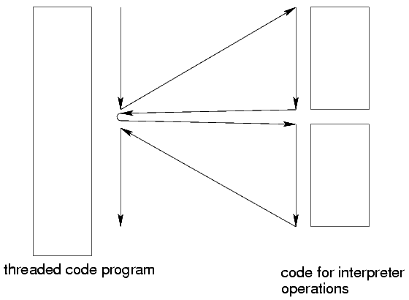
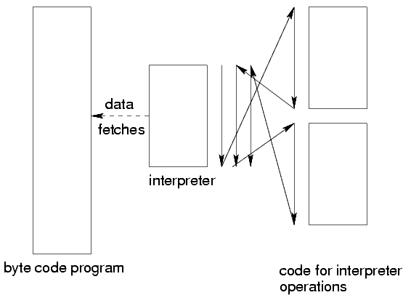
Byte Code vs. Threaded Code
Control flow behavior:
[based on: James R. Bell. Threaded Code. Communications of the ACM, vol. 16 no. 6, June 1973, pp. 370–372]
byte code:
threaded code:

Slide 23
Example
byte code |  | Op Table
17 |  | index | contents
23 |  | 17 | 10000
18 |  | 18 | 11000
23 |  | 23 | 12000
17 |  | 27 | 13000
17
Interpreter memory
Program ops
address | operation
10000 | add: …
11000 | sub: …
12000 | mul: …
13000 | div: …
 | …
add
mul
sub
mul
add add
direct threaded
10000
12000
11000
12000
10000 10000

Slide 24
EXERCISE
program
ops
byte code
?
byte-code op table
Interpreter memory
add | 10 000
sub | 20 000
mul | 30 000
store | 40 000
call | 50 000
return | 60 000
Index | Contents
0 | 10 000
1 | 30 000
2 | 40 000
3 | 60 000
4 | 50 000
5 | 20 000
add
mul
sub
add
store
add
return

Slide 25
EXERCISE
byte-code op table
byte code
program ops
?
Interpreter memory
add | 10 000
sub | 20 000
mul | 30 000
store | 40 000
call | 50 000
return | 60 000
Index | Contents
0 | 10 000
1 | 30 000
2 | 40 000
3 | 60 000
4 | 50 000
5 | 20 000
1
0
0
1
1
5
2
3

Slide 26
EXERCISE
program ops
direct threaded code
?
Interpreter memory
add | 10 000
sub | 20 000
mul | 30 000
store | 40 000
call | 50 000
return | 60 000
add
mul
sub
add
store
add
return

Slide 27
EXERCISE
direct-threaded code
program ops
?
Interpreter memory
add | 10 000
sub | 20 000
mul | 30 000
store | 40 000
call | 50 000
return | 60 000
20 000
10 000
40 000
20 000
10 000
10 000
40 000

Slide 28
Operands

Slide 29
Handling Operands 1: Stack Machines
Used by Pascal interpreters (’70s and ’80s); resurrected in the Java Virtual Machine.
Basic idea:
operands and results are maintained on a stack;
operations pop operands off this stack, push the result back on the stack.
Advantages:
simplicity
compact code.
Disadvantages:
code optimization (e.g., utilizing hardware registers effectively) not easy.

Slide 30
Stack Machine Code
The code for an operation ‘op x₁, …, x_{n}’ is:
push x_{n}
…
push x₁
op
Example: JVM code for ‘x = 1 – y*2’:
iconst 1 /* push the integer constant 1 */
iload y /* push the value of the integer variable y */
iconst 2
imul /* after this, stack contains: ⟨1, y*2⟩ */
isub
istore x /* pop stack top, store to integer variable x */

Slide 31
Generating Stack Machine Code
Essentially just a post-order traversal of the syntax tree:
void gencode(struct syntaxTreeNode ∗tnode )
{
if ( IsLeaf( tnode ) ) { … }
else {
n = tnode→n_operands;
for (i = n; i > 0; i--) {
gencode( tnode→operand[i] ); /* traverse children first */
} /* for */
gen_instr( opcode_table[tnode→op] ); /* code for the node */
} /* if [else] */
}

Slide 32
Handling Operands 2: Register Machines
Basic idea:
Have a fixed set of “virtual machine registers;”
Some of these get mapped to hardware registers.
Advantages:
potentially better optimization opportunities.
Disadvantages:
code is less compact;
interpreter becomes more complex (e.g., to decode VM register names).

Slide 33
Register Machine Example: Dalvik VM
Dalvik VM: runs Java on Android phones
designed for processors constrained in speed, memory
relies on underlying Linux kernel for thread support
register machine
depending on the instruction, can access 16, 256, or 64K registers
Example:
add-int dstReg_{8bit} srcRegA_{8bit} srcRegB_{8bit}
Java compiler
dx
(conversion tool)
.dex file
(Dalvik executable)
source code
.class file

Slide 34
Stack Machines vs. Register Machines
Stack machines are simpler, have smaller byte code files
Register machines execute fewer VM instructions (e.g., no need to push/pop values)
Dalvik VM (relative to JVM):
executes 47% fewer VM instructions
code is 25% larger
but instruction fetch cost is only 1.07% more real machine loads per VM instruction executed
space savings in the constant pool offset the code size increase

Slide 35
Just-in-Time Compilers (JIT)

Slide 36
Just-in-Time Compilers (JITs)
Basic idea: compile byte code to native code during execution.
Advantages:
original (interpreted) program remains portable, compact;
the executing program runs faster.
Disadvantages:
more complex runtime system;
performance may degrade if runtime compilation cost exceeds savings.

Slide 37
Improving JIT Effectiveness
Reducing Costs:
incur compilation cost only when justifiable;
invoke JIT compiler on a per-method basis, at the point when a method is invoked.
Improving benefits:
some systems monitor the executing code;
methods that are executed repeatedly get optimized further.

Slide 38
Interpreter + JIT Compiler: structure
Interpreter
Scanner
Parser
Bytecode Generator
byte code
Bytecode Executor
Input
program
AST
computation
results
Runtime system
(garbage collector, profiler, etc.)
frequently executed
byte code
machine code
IR Builder
IR Optimizer
Machine code generator
computation
results
execution
JIT Compiler
IR = Intermediate Representation

Slide 39
Method Dispatch: vtables
vtables (“virtual tables”) are a common implementation mechanism for virtual methods in OO languages.
The implementation of each class contains a vtable for its methods:
each virtual method f in the class has an entry in the vtable that gives f ’s address.
each instance of an object gets a pointer to the corresponding vtable.
to invoke a (virtual) method, get its address from the vtable.

Slide 40
VMs with JITs
Each method has vtable entries for:
byte code address;
native code address.
Initially, the native code address field points to the JIT compiler.
When a method is first invoked, this automatically calls the JIT compiler.
The JIT compiler:
generates native code from the byte code for the method;
patches the native code address of the method to point to the newly generated native code (so subsequent calls go directly to native code);
jumps to the native code.

Slide 41
JITs: Deciding what to Compile
For a JIT to improve performance, the benefit of compiling to native code must offset the cost of doing so.
E.g., JIT compiling infrequently called straight-line code methods can lead to a slowdown!
We want to JIT-compile only those methods that contain frequently executed (“hot”) code:
methods that are called a large number of times; or
methods containing loops with large iteration counts.

Slide 42
JITs: Deciding what to Compile
Identifying frequently called methods:
count the number of times each method is invoked;
if the count exceeds a threshold, invoke JIT compiler.
(In practice, start the count at the threshold value and count down to 0: this is slightly more efficient.)
Identifying hot loops:
modify the interpreter to “snoop” the loop iteration count when it finds a loop, using simple bytecode pattern matching.
use the iteration count to adjust the amount by which the invocation count for the method is decremented on each call.

Slide 43
Typical JIT Optimizations
Choose optimizations that are cheap to perform and likely to improve performance, e.g.:
inlining frequently called methods:
consider both code size and call frequency in inlining decision.
exception check elimination:
eliminate redundant null pointer checks, array bounds checks.
common subexpression elimination:
avoid address recomputation, reduce the overhead of array and instance variable access.
simple, fast register allocation.

Slide 44
Summary

Slide 45
Summary
Interpreters are common in modern computing environments
Design issues (⇒ portability/performance tradeoffs):
operation encoding (dispatch)
operands (stack vs. registers)
JIT compilers
create optimized code on the fly
usually based on identifying “hot” code at runtime
typically use cheap + effective optimizations

